Slide 1
5.1 The internet and the world wide web
The internet is the infrastructure
The world wide web is the collection of websites and web pages accessed using the internet
A URL is a text-based address for a web page; it can contain the protocol, the domain name and the web page/file name
The main purpose of a web browser is to render hypertext markup language (HTML) and display web pages
– storing bookmarks and favorites
– recording user history
– allowing use of multiple tabs
– storing cookies
– providing navigation tools
– providing an address bar
Understand the difference between the internet and the world wide web
Understand what is meant by a uniform resource locator (URL)
Describe the purpose and operation of hypertext transfer protocol (HTTP) and hypertext transfer protocol secure (HTTPS)
Explain the purpose and functions of a web browser
Describe how web pages are located, retrieved and displayed on a device when a user enters a URL
Explain what is meant by cookies and how they are used, including session cookies and persistent cookies
– the web browser
– IP addresses
– domain name server (DNS)
– web server
– HTML
Cookies are used for functions, including:
– saving personal details
– tracking user preferences
– holding items in an online shopping cart
– storing login details

Slide 2
Today
The internet is the infrastructure
The world wide web is the collection of websites and web pages accessed using the internet
A URL is a text-based address for a web page; it can contain the protocol, the domain name and the web page/file name
The main purpose of a web browser is to render hypertext markup language (HTML) and display web pages
– storing bookmarks and favorites
– recording user history
– allowing use of multiple tabs
– storing cookies
– providing navigation tools
– providing an address bar
Understand the difference between the internet and the world wide web
Understand what is meant by a uniform resource locator (URL)
Describe the purpose and operation of hypertext transfer protocol (HTTP) and hypertext transfer protocol secure (HTTPS)
Explain the purpose and functions of a web browser
Describe how web pages are located, retrieved and displayed on a device when a user enters a URL
Explain what is meant by cookies and how they are used, including session cookies and persistent cookies
– the web browser
– IP addresses
– domain name server (DNS)
– web server
– HTML
Cookies are used for functions, including:
– saving personal details
– tracking user preferences
– holding items in an online shopping cart
– storing login details
Understand: Features of a web browser
Able: How to use cookies
Answer: What’s the difference between HTML and the internet?

Slide 3
Extra for nothing
Cambridge says that for IGCSE, it should take 180 hours.
So they design IGCSE to try and fill 180 hours.
But, that means they add topics just to fill in time.
This topic, I think, is one of those topics.
Too easy and no way is there any new learning here.
But its in our syllabus so we must do.

Slide 4
What is?
Q: What is a network?
A: Two or more nodes connected together
Q: What is a LAN?
A: Local Area Network. A network within one building
Q: What is a WAN?
A: One LAN connected to another LAN across different buildings
Q: What is the Internet?
A: A giant WAN. A global connection of networks

Slide 5
The Internet
So if The Internet is a group of computers connected together, then what is the World Wide Web (WWW)?
The Internet = Group of computers connected together
WWW = Uses the internet to send information
Q: Can you have the internet without WWW?
A: Yes, you can have computers connected and not send anything, its pointless but you can have it.
Q: Can you have WWW without the Internet?
A: No, WWW needs the Internet to send information

Slide 6
WWW
The Internet is computers connected together
The world wide web (WWW) USES the internet to send information
The information it sends is website information
This website information has to be sent using specific rules. These rules are called
HTTP = Hypertext Transfer Protocol
You can use the internet for other things….like remote printing, email, torrents.... Theese use different protocols (POP, SMTP, FTP...)

Slide 7
WWW
We said that the WWW is used to send information and it uses the internet to send these things, but what information does it send?
Cambridge wants us to know that the WWW is used to send webpages and websites
Webpage = One page
Website = Many webpages
You access these websites / webpages by using a URL
URL = Uniform Resource Locator

Slide 8
Uniform Resource Locator - URL
http://www.bing.com
http://www.baidu.com
http://www.instagram.com
http://www.yinghua-school.com
Every URL is split into different parts.
The number of parts depends on how complicated the URL is.
Lets have a look at http://www.yinghua-school.com/engage/

Slide 9
Top level domain
.com
.cn
.net
.co.uk
.org
.gov
.jp

Slide 10
URL Parts
http://www.yinghua-school.com/engage
That is what Cambridge wants, but it’s too simple. A URL is actually: http://www.yinghua-school.com/engage
Protocol
Server’s Name / Website address
File Name / Webpage
Protocol
Says it uses WWW
Second Level Domain
Top Level Domain
File Name / Webpage

Slide 11
More complicated
A while ago, this school was going to have American courses. These courses were AP courses (Advanced Placement).
So I made http://www.ap.yinghua-school.com
Protocol
Says it uses WWW
Sub-domain
Second Level Domain
Top Level Domain

Slide 12
What about names and numbers
Hold on……..
When we did networks, we said that every computer has an IP address
And we use this IP address to go to that computer.
Well a website is just stored on a server, that server has an IP address but why can I type www.yinghua-school.com and I don’t have to type 46.30.215.123
Really, we should type in the IP address, but its hard to remember 46.30.215.123
So, we use words instead.
But how does your computer know that 46.30.215.123 is the address for www.yinghua-school.com?
It uses something called DNS
DNS = Domain Name System

Slide 13
DNS
The Domain Name System (DNS) allows you to type in a name and it links it to the correct IP address.
If you want to find the IP number for a website you can:
In Windows:
Press the Start / Windows button
Type CMD
In Mac
Open Applications > Utilities
Then type in ping <SPACE> and then whatever website you want <Enter>
Example:
ping www.bing.com

Slide 14

Domain Name and URL – Video Question
1. What does DNS stand for?
2. Is DNS the same as IP?
3. Why do we have DNS?
4. What's a domain name?
5. What does gTLD stand for?
6. A gTLD is on the left of the
last dot. True or False
7. Give an example of a ccTLD
8. What is a second level domain

Slide 15
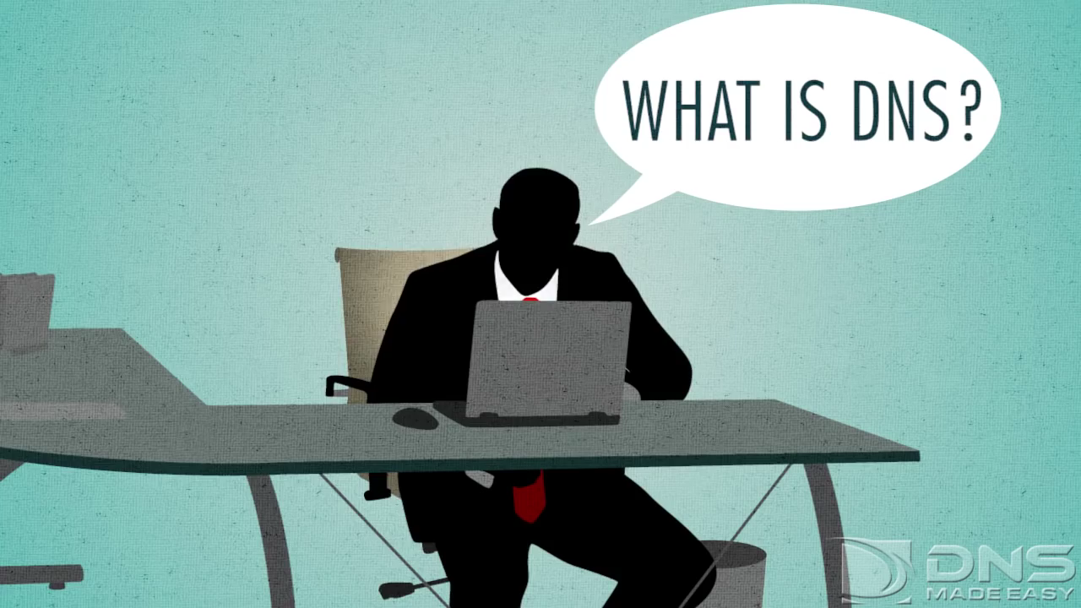
1. What are the strings of numbers called?
2. Is www.google.com. and www.google.com the same?
3. What does the end . represent?
4. If the address in not in cache, then who does the operating system ask?
5. What does the Resolving Name Server do?
6. What is the other name for the .com name servers?
7. What is the next set of severs after the .com name servers?
8. What's the difference between the register and the registry?
9. What server is the final one to tell the Resolving Name Server what the IP address is?
10. How quick is the process?

Slide 16
Domain Name System (DNS) Process
You type a website
Your OS looks in it CACHE memory to see if it knows
If it does not know then
OS asks the Resolving Name Server to find the IP Number
Resolving Name Server doesn’t know. So it goes to the Root Name Server
The Root Name Server doesn’t know. So it sends the Resolving Name Server to go to the Top-Level Domain (TLD) Name Server
The TLD Name Server doesn’t know, so it sends you to the Authoritative Name Server
The Authoritative Name Server does know because it checks the registry.
Registry = List of all the websites and their IP number
Register = Company that looks after this list
IP = Internet Protocol
OS = Operating System (Windows / MacOS/ iOS/ Android / Linux)
Browser > OS > Cache > Resolving Name Server > Root Name Server > TLD Name Server > Authoritative Name Server > Registry = IP Number

Slide 17
Browser
In that video it said ‘browser’
This means Web browser
WTF is a web browser?
The Internet = connection of computers
The World Wide Web = Uses the Internet to send website data with a HTTP protocol
Web Browser = Displays webpages written in HTML
HTML = Hypertext Markup Language

Slide 18
Web Browser
So a web browser is used to display HTML pages.
HTML = HyperText Markup Language
HTML is just a language used to create webpages.
We’ll make one now:

Slide 19
HTML
HTML = HyperText Markup Language
It’s the language used to make websites
It super easy and uses something called ‘tags’
Two types
< > Open Tag
</> Close Tag
When you write things inside tags its called nesting. For example <HEAD> is nested within <HTML>
https://onecompiler.com/html/

Slide 20
Notepad or https://www.htmlcompiler.net
<HTML>
</HTML>

Slide 21
Notepad
<HTML>
<HEAD>
</HEAD>
</HTML>

Slide 22
Notepad
<HTML>
<HEAD>
<TITLE> </TITLE>
</HEAD>
</HTML>

Slide 23
Notepad
<HTML>
<HEAD>
<TITLE> I will buy an iPhone 13 for my teacher </TITLE>
</HEAD>
</HTML>

Slide 24
Notepad
<HTML>
<HEAD>
<TITLE> I will buy an iPhone 13 for my teacher </TITLE>
</HEAD>
<BODY>
</BODY>
</HTML>

Slide 25
Notepad
<HTML>
<HEAD>
<TITLE> I will buy an iPhone 13 for my teacher </TITLE>
</HEAD>
<BODY>
Now I can type in here
</BODY>
</HTML>

Slide 26
Play with some tags
<h1> </h1>
<h2> </h2> …..<h6> </h6>
<b> </b>
<i> </i>
&lt;
<centre> </centre>
<p> </p>
<br>
<a href=”http://www.bing.com">Visit Bing</a>
<font size="2" color="blue">This is some text!</font>
<font face="verdana" color="green">This is some text!</font>
<img src=”INSERT IMAGE LINK HERE">
Notes:
<img src=”INSERT IMAGE LINK HERE">

Slide 27
Font Face
<font face="verdana" color="green">This is some text!</font>
Arial | face="Arial"
Arial Black | face="Arial Black"
Comic Sans MS | face="Comic Sans MS"
Courier New | face="Courier New"
Georgia | face="Georgia"
Impact | face="Impact"
Times New Roman | face="Times New Roman"
Trebuchet MS | face="Trebuchet MS"
Verdana | face="Verdana"

Slide 28
Problem with colours:
What are these colours called?

Slide 29
Problem with colours:
We need to use colour codes and not names. There are not enough names.

Slide 30
Hexadecimal Colour Codes
We use it for HTML colour codes
Every colour you see on a screen is a mixture of red, green and blue
It can range from 0 (nothing) to 255 (the maximum amount)
So pure red will have 255 red, 0 green, 0 blue

Slide 31
So what?
Well, because we have many colours and many colour combinations – we use hex
HTML colour codes all start with a #
The first two characters say how much red, the next two is how much green and the next two how much blue
So pure red will be:
#FF0000
https://html-color-codes.info

Slide 32
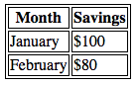
Tables
Start of table
Table Row <tr>
Table Header <th>
<table>
<tr>
<th>Month</th>
<th>Savings</th>
</tr>
<tr>
<td>January</td>
<td>$100</td>
</tr>
</table>

Slide 33
Web Browser features
Okay, when web browsers were first made, yes, all they can do is display HTML.
But now browsers can do many things:
– storing bookmarks and favorites
– recording user history
– allowing use of multiple tabs
– storing cookies
– providing navigation tools
– providing an address bar

Slide 34
Cookies
Ah such a stupid term.
A cookie is the name of file, its actually just a text file.
But it holds some information about you.
When you visit a (European) website, it will ask if you accept cookies. If you allow this to happen, then the website will store this text file, this cookie, on your computer.
The next time you go to the same website, it will look at the cookie to get some of your information
Notes:
Explain what is meant by cookies and how they are used, including session cookies and persistent cookies
Cookies are used for functions, including:
– saving personal details
– tracking user preferences
– holding items in an online shopping cart
– storing login details

Slide 35
What do cookies store?
Personal Details
Name
Address
Phone Number
Email
Bank information
User Preferences
Colour scheme of website
Language of website
Text size of website
Shopping Information
Items in cart not yet paid for
Items you might like
Login Information
Username
Passwords
Notes:
Explain what is meant by cookies and how they are used, including session cookies and persistent cookies
Cookies are used for functions, including:
– saving personal details
– tracking user preferences
– holding items in an online shopping cart
– storing login details

Slide 36
Isn’t that dangerous?
Yes it is.
If someone steals your computer, or even just looks at it for a few minutes, they can copy your cookies / information in your cookies and now they have some of your data.
So, now, browsers may use incognito / private browsing. This does not allow any cookies to be saved.
Also, there is something called persistent cookies and session cookies.
Persistent Cookie:
This cookie is stored on your computer until you decide to remove it
Session Cookie
This cookie is stored on your computer until you close your web browser and then it automatically gets removed

Slide 37
Task
Make a webpage that:
Has five different font colours
Two different fonts
Two different font styles
Underlined text
Bold text
Two links to another website
Background colour that is NOT white
An image
A less than sign “<“
Text in the middle of the page
A paragraph
A break line
A simple table
An image
A table with a border
Inside the table is text that is in a different colour

Slide 38
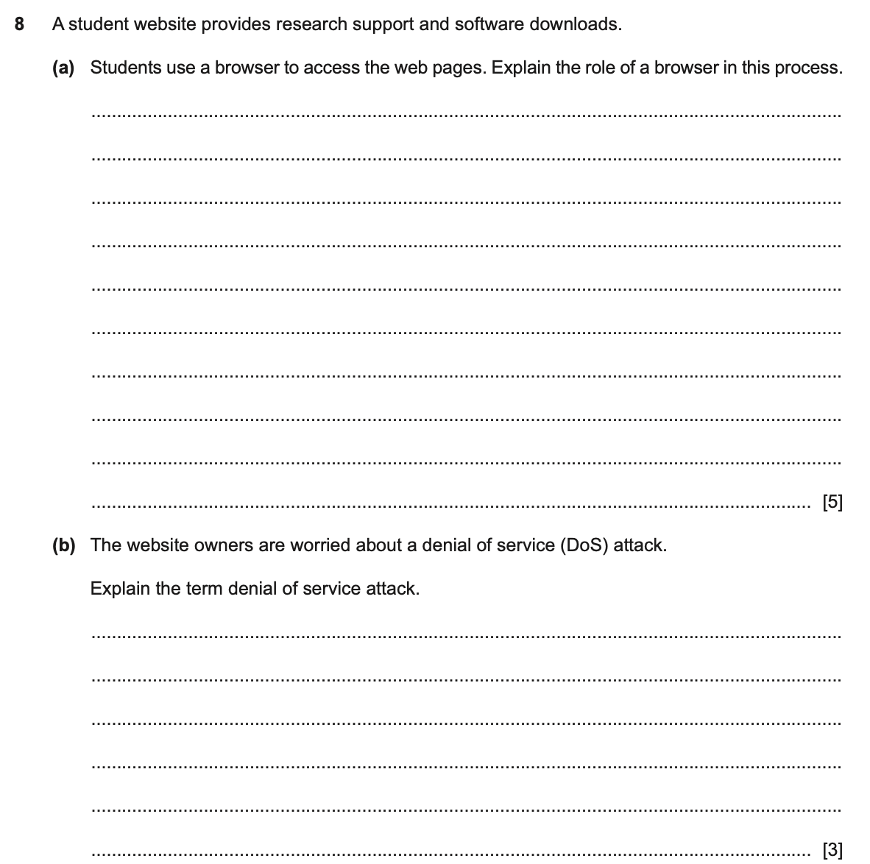
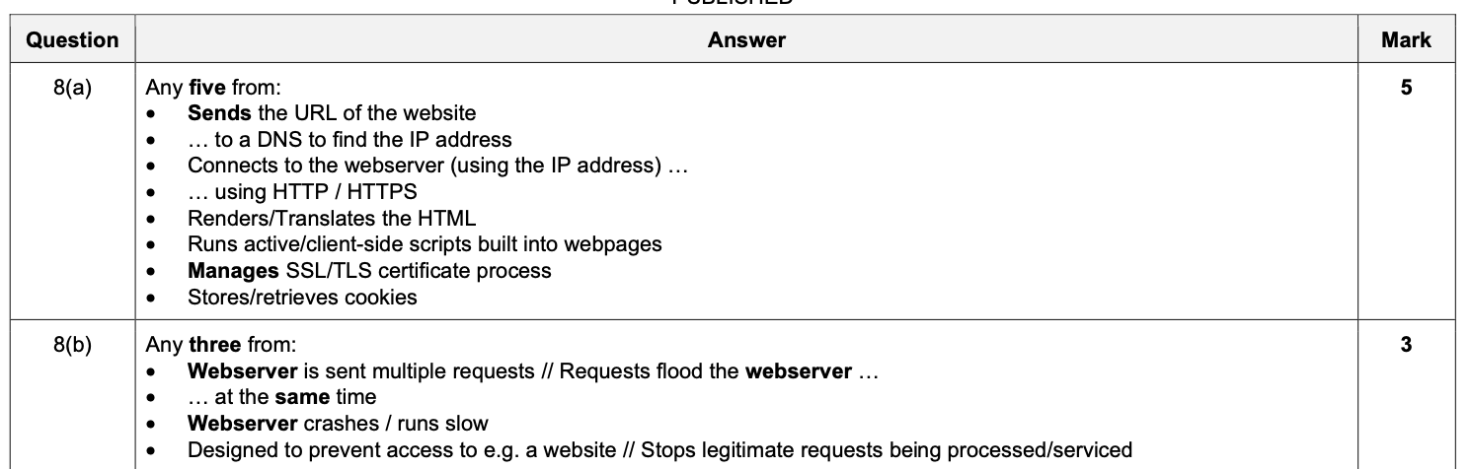

Slide 39
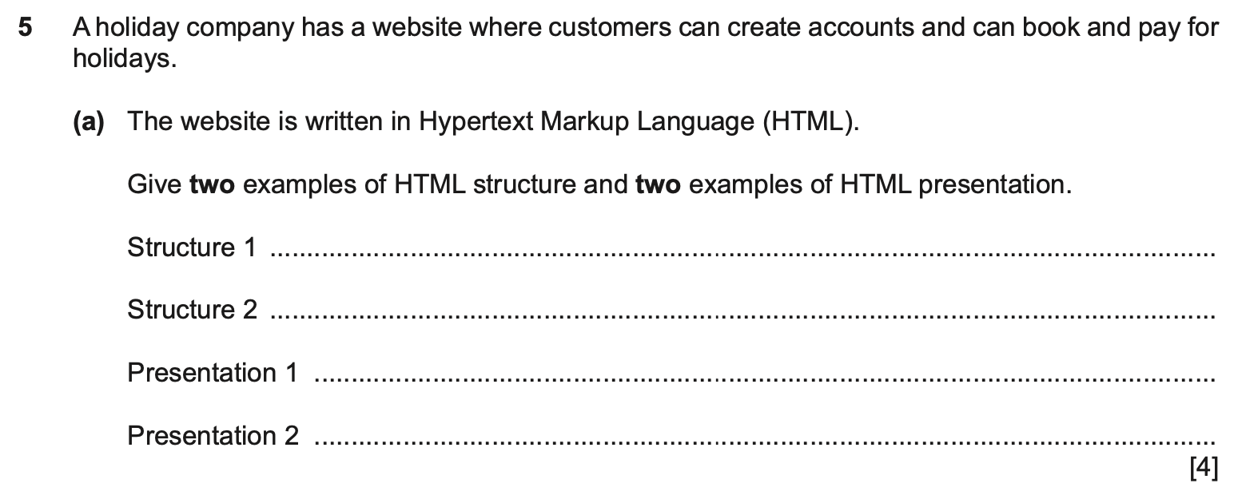
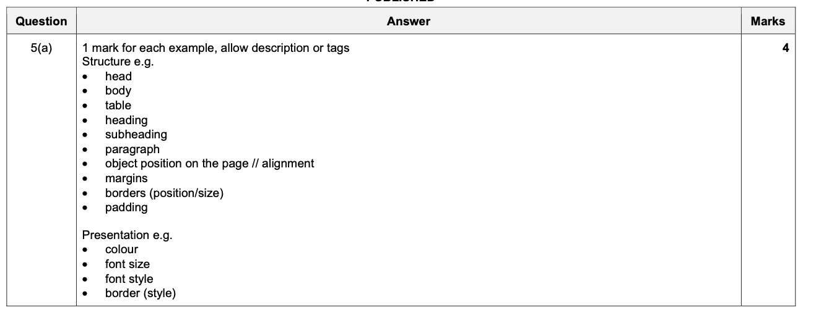

Slide 40
